Slide 1
Decarbonizing/Electrifying the Building Sector
By: Sue Coakley, Executive Director
Northeast Energy Efficiency Partnerships
At: New England Electricity Restructuring Roundtable (#162)
June 21, 2019

Slide 2
About Northeast Energy Efficiency Partnerships
“Assist the Northeast and Mid-Atlantic region to reduce building sector energy consumption 3% per year and carbon emissions 40% by 2030"
Mission
We seek to accelerate regional collaboration to promote advanced energy efficiency and related solutions in homes, buildings, industry, and communities.
Vision
We envision the region's homes, buildings, and communities transformed into efficient, affordable, low-carbon, resilient places to live, work, and play.
Approach
Drive market transformation regionally by fostering collaboration and innovation, developing tools, and disseminating knowledge
One of six Regional Energy Efficiency Organizations (REEOs) funded in-part by U.S. DOE to support state and local efficiency policies and programs.

Slide 3
Is the Northeast Region on the Path to 80% by 2050?
17% change
76% change
Source: Historic carbon emissions data from EIA, trajectory calculated based on regional carbon levels in 2001
Notes:
The region has achieved some carbon reduction, but in order to achieve 80 percent by 2050 from all sectors, states need to invest more in energy efficiency, strategically electrify end-uses (building HVAC and transportation), and power the grid with renewable energy.
Where are the emissions coming from?

Slide 4
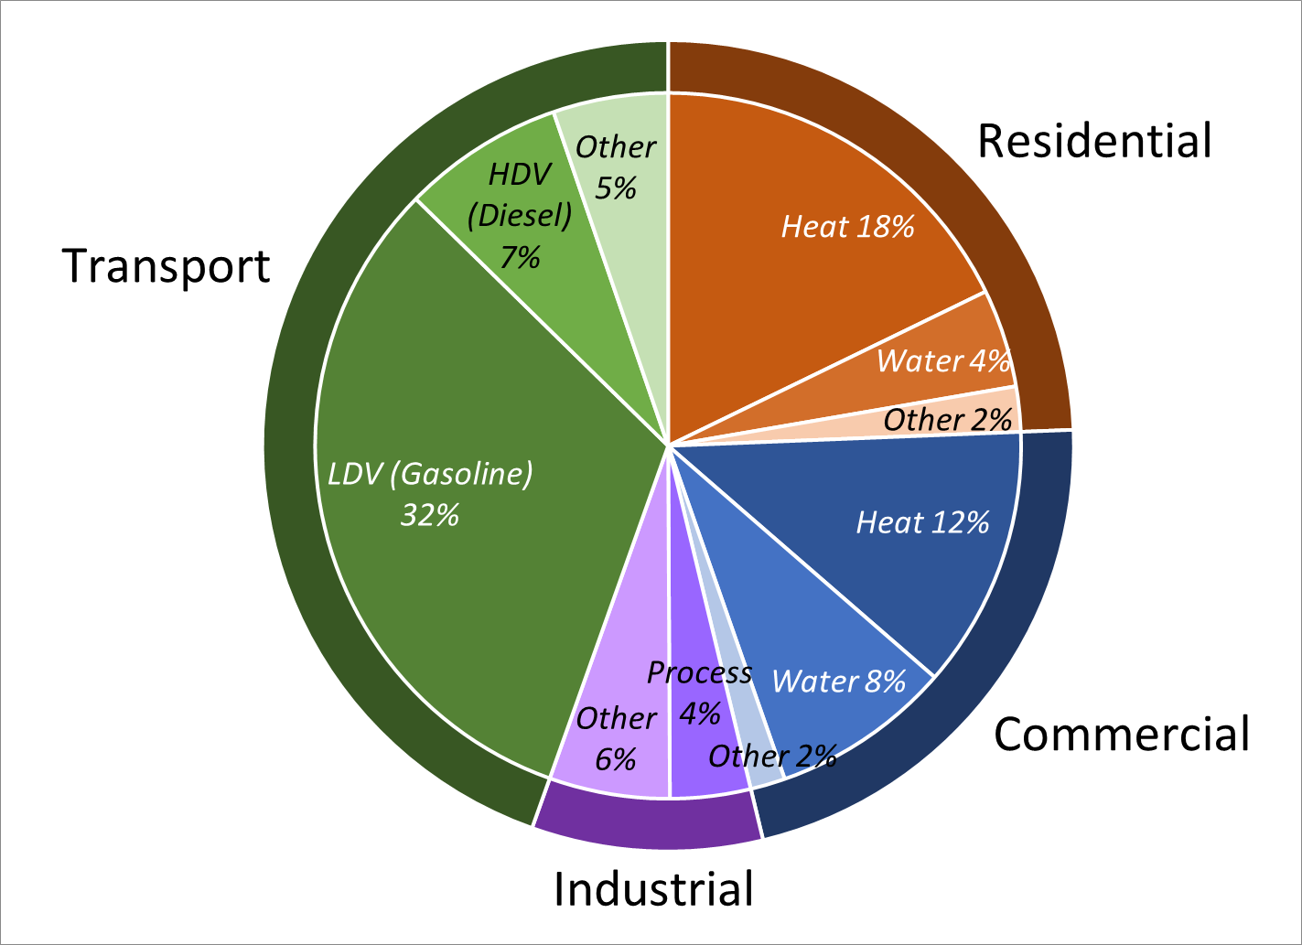
Direct End Uses of Fossil Fuels = 76% of Carbon Emissions in NY and New England
Buildings = 35% of Regional GHG Emissions
Source: Northeast Regional Strategic Electrification Assessment – NEEP 2017

Slide 5
Building Decarbonization ➔ 3 Key Elements
Space/Water Heating – Heat Pumps
Thermal Improvements
Flexible use of Low-Carbon Electricity
Northeast Strategic Electrification Action Plan – NEEP 2018

Slide 6
Advanced Heat Pump Market Transformation Strategy
Focus on natural market cycles of building construction, renovation and equipment replacement
Programs to increase market adoption rates:
Equipment Replacement: Advanced heat pump incentives for heating and cooling equipment
New Construction and Building Renovation: Incentives and technical assistance (link to “stretch codes”)
Prioritize Low Income: Partner with affordable housing, community development and weatherization programs
Building standards to accelerate market cycles:
Advanced Building Energy (zero energy/carbon by 2032)
Voluntary stretch codes to build market capacity
Workforce Development and Quality Assurance
Consumer Education

Slide 7
Advanced Heat Pump Market Transformation by 2050 New England + New York: Plausibly Optimistic Scenario
Increasing heat pump market adoption in natural residential & commercial sector market cycles
Analysis by Dr. Asa Hopkins, Synapse Energy Economics – June 2019

Slide 8
Heat Pump Market Transformation by 2050: Major Progress Towards IEPCC Climate Stabilization Goals
100% Carbon Free Electricity by 2050
IEPCC: GHG Emissions 45% below 2010 in 2030
Transportation: Broad Adoption of Electric Vehicles
IEPCC: GHG Emissions 0% by 2050
Buildings: Broad Adoption of Advanced Heat Pumps
Does not include improved building thermal efficiency

Slide 9
SIZING UP THE CHALLENGE: Residential Efficiency Retrofits + Heating Electrification New England + NY
14.6 million homes
20% of regional carbon emissions
73% built before 1980
80%+ need:
Efficiency retrofits and associated repairs
Heat pumps
$5,000 - $30,000 per home
Total Cost: $200 billion +
Over 30 years:
Heat Pumps = $2 billion per yr.
Total Retrofit with HP = $8 billion per yr.
2017 New England + NY Expenditures:
Efficiency Programs = $600 Million
Home Heating Fuel Cost = $12.5 Billion
Multiple Benefits – health, comfort, safety, resilience
Sources: US Census Bureau, US Energy Information Administration, NEEP Regional Energy Efficiency Database

Slide 10
Public Policies to Accelerate Building Decarbonization
Statewide Carbon Reduction Goals
Utility Regulation
Rate Design
Efficiency Programs – total building performance, all fuels, low carbon
Smart Buildings & Grid investment
Building Standards
Advanced Building Energy Codes
Building Energy Rating & Disclosure
Building energy standards for all buildings
Community Leadership
Supported by state efforts
Supporting Policies
Buildings as Grid Assets
Renewable Energy
Energy Storage
Lead-by-Example
Workforce Development
Financing
Policy Linkages
Energy & Housing Affordability
Health Care
Community & Economic Development

Slide 11
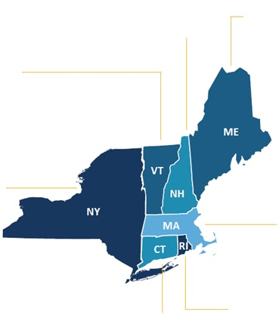
Highlights of Regional Policy/Program – Buildings Decarbonization
VERMONT
Incentives for ASHPs and HPWHs through Efficiency VT and utilities
Tier 3: GMP ASHPs and HPWHs for RES compliance
Montpelier – Building Energy Standards & Disclosure new and existing homes & buildings
NEW HAMPSHIRE
Developed first-in-nation RPS carveout for renewable thermal
ASHP and HPWH rebates from individual utilities
MAINE
Significant uptake in residential ASHP/HPWH through Efficiency Maine rebate and financing programs (over 20,000 rebates FY14-FY16)
MASSACHUSETTS
Renewable thermal energy into Alternative Portfolio Standard
ASHP, GSHP, and HPWH rebates via state and utility programs
Solarize Mass Plus will include heat pumps, EVs, and storage
Expanded cost-benefit test to recognize health, safety, comfort values of deep efficiency
NEW YORK
New York REV - Policy
NYSERDA Clean Energy Investment Plan
NYSERDA & utility Heat Pump Incentives
Workforce Development
NYC Multifamily Retrofit & Heat Pump initiatives
NYC Bldg Carbon Emission Cap
RHODE ISLAND
ASHP Incentives, Building Energy Rating
Exploring workforce development programs to drive heat pump uptake (e.g. engaging delivered fuel dealers)
CONNECTICUT
Heat pump rebates through Energize CT
Home Energy Scores

Slide 12
NEEP Regional Market Transformation Initiatives
Overcoming Market Barriers through Regional Collaboration
Air Source Heat Pumps and Smart Controls
Advanced Building Energy Codes and Standards
Building Energy Benchmarking
Home Energy Labels and HELIX
Smart Energy Homes
Building Decarbonization Best Practice Public Policies
R&D Connector: Buildings as Grid Assets
2019 Electrification Symposium

Slide 13
2019 NEEP Summit - Electrification Symposium: Pathways to Decarbonization in the Northeast
Notes:
Allies free passes
Contact Lucie if interested in joining industry events – NEEP might have discounts for its Allies

Slide 14
NEEP Resources
Northeast/Mid-Atlantic ASHP Market Transformation:
Regional High Performance Heat Pump Project & Working Group: https://neep.org/ashp
Regions ccASHP Market Transformation Strategy: http://www.neep.org/sites/default/files/NEEP_ASHP_2016MTStrategy_Report_FINAL.pdf
Cold Climate ASHP Product List: https://neep.org/initiatives/high-efficiency-products/emerging-technologies/ashp/cold-climate-air-source-heat-pump
NEEP’s Strategic Electrification Resource Center: http://www.neep.org/initiatives/strategic-electrification
Strategic Electrification Resource Catalog: http://www.neep.org/sites/default/files/NEEP%20Strategic%20Electrification_Resource%20Catalogue_Updated%20April%202018.pdf
Action plan to Accelerate Strategic Electrification in the Northeast and Mid-Atlantic: http://neep.org/reports/strategic-electrification-action-plan
Regional Assessment of Strategic Electrification Report: http://www.neep.org/reports/strategic-electrification-assessment
2017 Strategic Electrification Summit: http://www.neep.org/events/2017-regional-strategic-electrification-summit

Slide 15
For more information: www.neep.org Phone: 781-860-9177 Sue Coakley, Executive director scoakley@neep.org - ext. 112 Dave Lis Director of Technology & Market Solutions djlis@neep.org – ext. 127 Carolyn Sarno Goldthwaite Director of Building & Community Solutions cgoldthwaite@neep.org - ext. 119

